Slide 1
The Risk Management in Projects

Slide 2
Definitions
Risk
An uncertain event or condition that, if occurs, has a positive or negative effect on the project objectives.
Project Risk Management
Includes the processes concerned with conducting risk management planning, identification, analysis, responses, and monitoring and control of a project; most of these processes are updated throughout the project.
The objectives of project risk management are to increase the probability and impact of positive events and decrease the probability and impact of events adverse to the project.

Slide 3
Negative Risk
A dictionary definition of risk is “the possibility of loss or injury”
Negative risk involves understanding potential problems that might occur in the project and how they might impede project success
Negative risk management is like a form of insurance; it is an investment
Information Technology Project Management, Sixth Edition
‹#›

Slide 4
Risk Can Be Positive
Positive risks are risks that result in good things happening; sometimes called opportunities
A general definition of project risk is an uncertainty that can have a negative or positive effect on meeting project objectives
The goal of project risk management is to minimize potential negative risks while maximizing potential positive risks
Information Technology Project Management, Sixth Edition
‹#›

Slide 5
The Importance of Project Risk Management:
Project risk management is the art and science of identifying, analyzing and responding to risk throughout that life of a project & in best interests of meeting project objective.
Risk management can have a positive impact on selecting project, determining the scope of projects & developing realistic schedules & cost estimates.
It helps projects stakeholders understand the nature of the project, involves team members in defining strengths & weakness & helps to integrate the other project management knowledge areas.
A good risk management is responsible for the smooth development of a new system,.
PRM involves understanding potential problems that might occur on the project & how they might impede project success.

Slide 6
Common Mistakes in Managing Project Risk
Not understanding the benefits of risk management
Not providing adequate time for risk management
Not identifying and assessing risk using a standardized approach
Effective & Successful Risk Management Requires
Commitment by all stakeholders
Stakeholder responsibility
Different risks for different types of projects

Slide 7
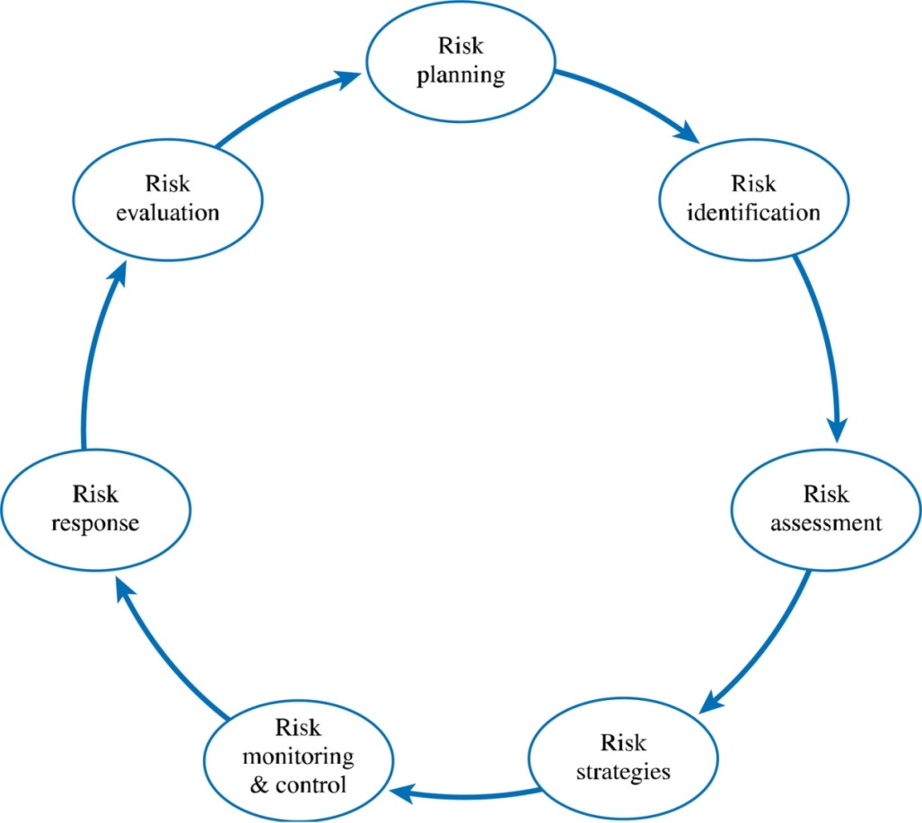
Risk Management Processes
Risk management planning
Risk identification
Qualitative risk analysis
Quantitative risk analysis
Risk response planning
Risk monitoring and control

Slide 8
Project Risk Management Processes
Planning risk management: deciding how to approach and plan the risk management activities for the project
Identifying risks: determining which risks are likely to affect a project and documenting the characteristics of each
Performing qualitative risk analysis: prioritizing risks based on their probability and impact of occurrence
Information Technology Project Management, Sixth Edition
‹#›

Slide 9
Project Risk Management Processes (continued)
Performing quantitative risk analysis: numerically estimating the effects of risks on project objectives
Planning risk responses: taking steps to enhance opportunities and reduce threats to meeting project objectives
Monitoring and controlling risks: monitoring identified and residual risks, identifying new risks, carrying out risk response plans, and evaluating the effectiveness of risk strategies throughout the life of the project
Information Technology Project Management, Sixth Edition
‹#›

Slide 10
There are SIX major processes involved in Risk Management.
1. RISK MANAGEMENT PLANNING:
It involves deciding How to approach & plan the risk management activities for the project.
By reviewing the project scope statements, project management plan, environment factors, & organizational process assets, project team can discuss & analyze risk management activities for their particular project.
OUTPUT: -The main output of this process is a risk management plan.
2. RISK IDENTIFICATION:
It involves determining which risk are likely to affect a project & documenting the characteristics of each.
OUTPUT:- The main output of this process is the start of a risk register.
RISK REGISTER:
It is a document that contains results of various risk management process, often displayed in a table format.

Slide 11
Risk Register
The main output of the risk identification process is a list of identified risks and other information needed to begin creating a risk register
A risk register is:
A document that contains the results of various risk management processes and that is often displayed in a table or spreadsheet format
A tool for documenting potential risk events and related information
Risk events refer to specific, uncertain events that may occur to the detriment or enhancement of the project
Information Technology Project Management, Sixth Edition
‹#›

Slide 12
Risk Register Contents
An identification number for each risk event
A rank for each risk event
The name of each risk event
A description of each risk event
The category under which each risk event falls
The root cause of each risk
Information Technology Project Management, Sixth Edition
‹#›

Slide 13
Risk Register Contents (continued)
Triggers for each risk; triggers are indicators or symptoms of actual risk events
Potential responses to each risk
The risk owner or person who will own or take responsibility for each risk
The probability and impact of each risk occurring
The status of each risk
Information Technology Project Management, Sixth Edition
‹#›

Slide 14
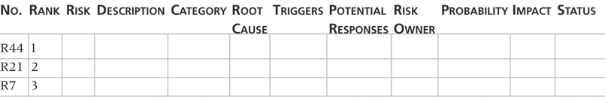
Table 11-5. Sample Risk Register
‹#›
Information Technology Project Management, Sixth Edition

Slide 15
Continue…
3. Qualitative Risk Analysis:-
It involves prioritizing risks based on their probability and impact of occurrence.
After identifying risks, project teams can use various tools and techniques to rank risks and update information in the risk register.
Output: - The main output is updates to the risk register.
4. Quantitative Risk Analysis:-
It involves numerically estimating the effects of risks on project objectives.
Output: - The main output of this process is also updates to the risk register.
5. RISK RESPONSE PLANNING:-
Involves taking steps to enhance opportunity and reduce threats to meeting project objectives. Using o/p from the preceding risks management processes, project teams can develop risk response processes, project teams can develop risk response strategies that often result in updates to the risk register and project management plan as well as a risk related contracted agreement.

Slide 16
Continue…
6. RISK MONITORING AND CONTROL:-
It involves monitoring identified risks, identifying new risks, carrying out risk response plans, and evaluating the effectiveness of risk strategies throughout the life of the project.
Output: - The main outputs of this process include recommended corrective and preventive actions, requested changes, and updates to the risk register, project management plan, and organizational process assets.

Slide 17
Risk Management Planning:
Risk management planning is the process of deciding how to approach & plan for risk management activities for a project & main output of this process is a risk management plan.
A risk management plan document the procedure for managing risks throughout the projects.
Project teams should hold several planning meeting early in the project’s life cycle to help develop the risk management plan.
A risk management plan summarizes how risk management will be performed on a particular project.

Slide 18
Risk Management Planning:
Following are topics addressed in a RMP:
Methodology: how will risk management be performed on project & what tools& data sources are available & applicable?
Roles & responsibilities: who are individuals responsible for a implementing specific task related to risk management?
Risk budget & schedule: what are estimate costs & schedule for performing risk related activities?
Risk categories: what are the main categories of risks that should be addressed on this project?
Risk probability & impact: how will be probabilities & impact of risk items be accessed?
Risk documentation: what reporting formats &processes will be used for risk management activities?

Slide 19
Risk management
Common source of risk on information technology projects:
Analysis shows that information technology projects share some common sources of risk.
Many organizations develop their own risk questionnaires, categories of risk described on these questionnaires might include:
Market risk
Financial risk
Technology risk
People risk
Structure / process risk

Slide 20
RISK QUESTIONNAIRES
Market risk :
Following questionnaires comes as a part of market related risks:
If the information technology project is to produce a new product or service, will it be useful to the organization or marketable to others?
Will users accept & use the product or service?
Will someone else create a better product or service faster, making the project waste of time & money?

Slide 21
RISK QUESTIONNAIRES
FINANCIAL RISK:-
Can the organization afford to undertake the project?
How confident are the stakeholders in the financial projections?
Financial projections:-
Will the project meet the NPV, ROI & payback estimation?
If not, can the organization afford to continue the project ?
Is this project the best way to use the organization’s financial resources?

Slide 22
RISK QUESTIONNAIRES
TECHNOLOGY RISK :-
Is the project technically feasible ?
Will it use mature, leading edge technologies ?
When will decisions be made on which technology to use ?
Will the technology be available in time to meet project objectives ?
Will hardware, software, & networks function properly ?
Could the technology be obsolete before a useful product can be produced?
You can also break down the technology risk category into hardware, software and network technology if desired

Slide 23
RISK QUESTIONNAIRES
PEOPLE RISK:-
Does the organization have or can they find people with appropriate skills to complete the project successfully?
Do people have the proper managerial and technical skills?
Do they have enough experience?
Is the organization familiar with the sponsor or the customer for the project?
How good is the relationship with the sponsor/customer?

Slide 24
RISK QUESTIONNAIRES
STRUCTURE/PROCESS RISK :-
What is the degree of change the new project will introduce into user areas and business procedures?
How many distinct user groups does the project need to satisfy?
With how many other systems does the new project/system need to interact?
Does the organization have processes in place to complete the project successfully?
Reviewing a proposed project in terms of a risk questionnaires or any other similar tool is a good method for understanding common sources of risk on information technology projects.

Slide 25
Risk Breakdown Structure:-
A risk breakdown structure is useful tools that can help project managers consider potential risks in different categories.
Similar in structure to a WBS, a RBS is a hierarchy of potential risk categories for a project
Fig shows a sample risk breakdown structure that might apply to many information technology projects.
Highest level categories are business, technical, organizational, and project management.
Under business risks are the categories of competitors, suppliers and cash flow.
Under technical risks are the categories of h/w, s/w and network.
The RBS provides a simple, one page chart to help ensure a project team is considering important risk categories related to all information technology projects.

Slide 26
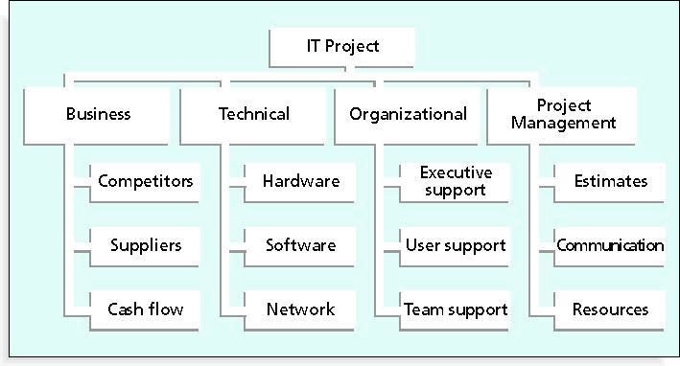
Risk Breakdown Structure

Slide 27
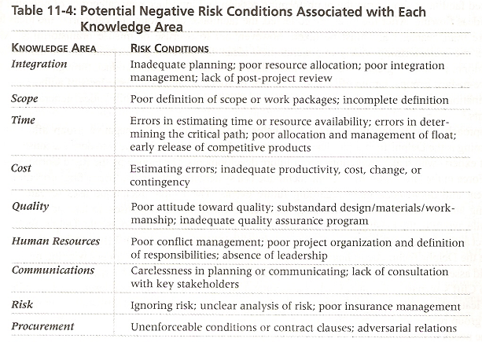

Slide 28
Risk Identification
Identifying risks is the process of understanding what potential events might hurt or enhance a particular project.
There are several tools and techniques for identifying risks.
Project teams often conduct the risk identification process by reviewing project documentation, recent and historical information related to the organization.
Project team members and outside experts often holds meetings to discuss this information and ask important questions about them as they relate to risk.
After identifying potential risks at this initial meeting, the project team might then use different information gathering techniques to further identify risks.
Five common information gathering techniques include
Brainstorming
Delphi technique
Interviewing
Root cause analysis
SWOT Analysis

Slide 29
FIVE COMMON INFORMATION GATHERING TECHNIQUES
Brainstorming:
Brainstorming is a technique by which a group attempts to generate ideas or find a solution for a specific problem.
This approach can help the group create a comprehensive list of risks to address later in the qualitative and quantitative risk analysis process.
An experienced facilitator should run the brainstorming session and introduce new categories of potential risks to keep the ideas flowing.
After the ideas are collected, the facilitator can group and categorize the ideas to make them more manageable.
Group effects, such as fear of social disapproval, the effects of authority hierarchy and domination of the session by one or two very vocal people often inhibit idea generation for many participants.

Slide 30
FIVE COMMON INFORMATION GATHERING TECHNIQUES
Delphi Technique:
An approach to gathering information that helps prevent some of the negative group effects found in brainstorming is the Delphi technique.
The basic concept of the Delphi technique is to derive a consensus among a panel of experts who make prediction s about future developments.
The Delphi Technique is a systematic, interactive forecasting procedure based on independent input regarding future events.
The Delphi Technique uses repeated rounds of questioning and written responses, including feedback to earlier-round responses to take advantage of group input while avoiding the biasing effects possible in oral panel deliberations.
To use the Delphi technique, you must select a panel of experts for the particular area in question.
E.g.:- Delphi technique, can be used to understand why particular organization is no longer winning many contracts.

Slide 31
FIVE COMMON INFORMATION GATHERING TECHNIQUES
Interviewing:
Interviewing is a fact-finding technique for collecting information in face-to-face, phone, e-mail, or instant messaging discussions.
Interviewing people with similar project experience is an important tool for identifying potential risks.
For example, if a new project involves using a particular type of hardware or software, someone with recent experience with that hardware or software could describe problems he/she had on past project.
If someone has worked with a particular customer, he or she might provide insights into potential risks involved in working for that group again.

Slide 32
FIVE COMMON INFORMATION GATHERING TECHNIQUES
Root Cause Analysis:
It is not uncommon for the people to identify problems or opportunities without really understanding them.
Before suggesting course of action, it is important to identify the root cause of a problem or opportunity.
Root Cause Analysis often results in identifying even more potential risks for the project.

Slide 33
FIVE COMMON INFORMATION GATHERING TECHNIQUES
SWOT Analysis:
SWOT Analysis (Strength, Weakness, Opportunities and Threats) which is often used in strategic planning.
SWOT Analysis can also be used during risk identification by having project teams focus on the broad perspectives of potential risks for particular projects.
Ex: Before writing a particular proposal, a group of employees discuss in detail what their company’s strength are, what their weaknesses are related to that project and what opportunities and threats exist.
Applying SWOT to specific potential projects can help identify the broad risks and opportunities that apply in that scenario.

Slide 34

SWOT Analysis

Slide 35
Qualitative Risk Analysis:
Qualitative risk analysis involves assessing the likelihood and impact of identified risks, to determine their magnitude and priority.
A project manager can make a chart the probability and impact of risks on a probability / impact matrix or chart.
A probability/ impact matrix or chart lists the relative probability of a risk occurring an one side of a matrix on a chart and relative impact of the risk occurring on the other.

Slide 36
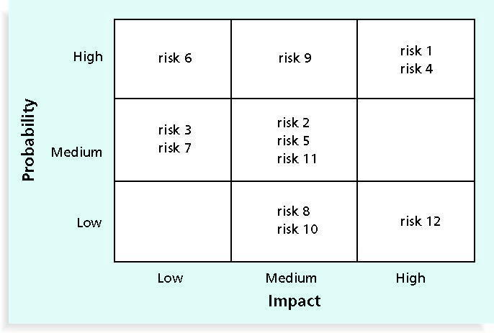
Qualitative Risk Analysis
Risk 1 and 4 are listed as Impact high in both categories of probability and impact
Risk 6 is high in probability category but low in impact.
Risk 9 is high in probability category but medium in impact.
Risk 12 is low in probability category but high in impact.
The team should then discuss how they plan to respond to those risks if they occur.

Slide 37
Top Ten Risk Item Tracking:
Top ten risk item tracking is a qualitative risk analysis tool and in addition to identifying risks, it maintains an awareness of risks throughout the life of a project.
It involves establishing a periodic review of the projects most significant risk items with management and optimality with the customer.
The review begins with a summary of the status of the top ten sources of risk on the project.
It includes each items current ranking, preview ranking, number of times it appears on the list over period of time, and summary of progress made in resolving the risk item since previous review.

Slide 38
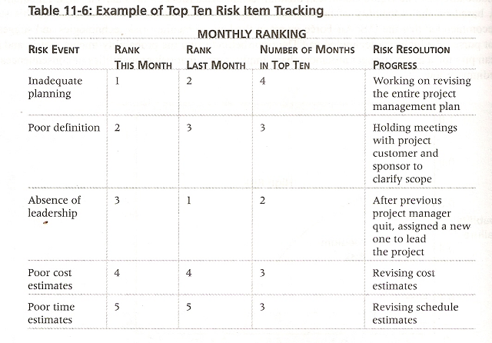

Slide 39
Quantitative Risk Analysis:-
Quantitative risk analysis often follows qualitative risk analysis, yet both can be done together or separately.
The main techniques for quantitative risk analysis include data gathering, and modeling techniques.
Data gathering often involves interviewing, expert judgment, and collection of probability distribution information.
And modeling techniques’ includes decision tree analysis.

Slide 40
Decision tree and Expected monetary value (EMV):
A decision tree is a diagramming analysis technique used to help select the best course of action in situation in which future outcome are uncertain.
A common application of decision tree analysis involves calculating expected monetary value.
Expected monetary value (EMV) is the product of risk event probability and risk events evaluates monetary value.
Fig below uses the decision of which projects an organization might pursue.
Organization was trying to decide if it should submit a proposal for project 1, project 2, both project or one project or neither project.
The team could draw a decision tree with two branches ,one for project 1 and one for project 2 and firm could then calculate the EMV to help make this decision .

Slide 41
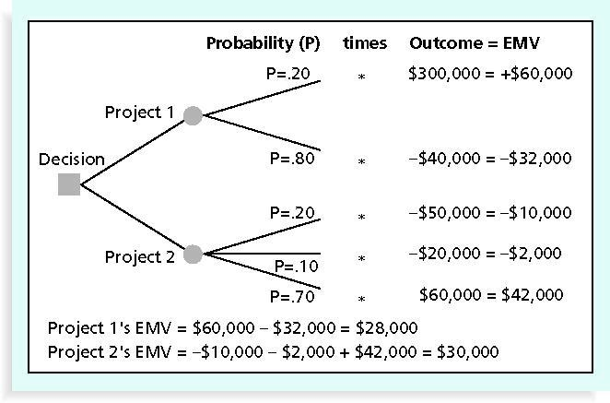
Decision tree and Expected monetary value (EMV):

Slide 42
Decision tree and Expected monetary value (EMV):
Project 1 EMV= $60,000-$32,000=$28,000.
Project1 EMV=-$10,000-$2,000+$42,000=$32,000.
In fig, – there is 20 % probability or chance (p=0.20) that firm will win the contract for project1 which is estimated to be worth $300,000 in profits.
There is 80% probability (p=0.80) that it will not win the contract for project1 and the outcome is estimated to be -$40,000, meaning that the firm have to invest $40,000 into project1 with no reimbursement if it is not awarded the contract.
The sum of the probabilities for outcome for each project must equal one.

Slide 43
Risk Response Planning:
After an organization identifies and qualifies risk, it must develop an appropriate response to them.
Developing a response to risks involves developing options and defining strategy for reducing negative risks and defining strategies for reducing negative risks and enhancing positive risks.
FOUR BASIC RESPONSE STRATEGIES FOR NEGATIVE RISKS:
Risk avoidance:
Risk avoidance or eliminating a specific threat, usually by eliminating its cause.
Example:-A project team may decide to continue using a specific piece of h/w or s/w on a project because they know it works.
Other products that could be used on the project may be available , but if the project team is unfamiliar with them , they could cause significant risk.
Using familiar h/w or s/w eliminates this risk.
NOTE: Of course, not all risks can be eliminated, but specific risk events can be.

Slide 44
Risk Response Planning:
Risk acceptance:
Risk acceptance or accepting the consequences should a risk occur.
E.g.:-A project team planning a big project review meeting could take an active approach to risk by having a contingency or a backup plan and contingency reserves if they can’t get approval for a specific site for the meeting. On the other hand they could take a passive approach and accept whatever facility their organization provides them.
Risk transference:
Risk transference or shifting the consequence of a risk and responsibility for its management to the third party.
E.g.:- A project team may purchase special insurance or warranty protection for specific hardware needed for the project.If the hardware fails, the insures must replace it within an agreed upon period of time.

Slide 45
Risk Response Planning:
Risk mitigation:
Risk mitigation or reducing the impact of a risk event by reducing the probability of its occurrence.
Examples:
Using proven technology.
Having competent project personnel.
Buying maintenance or service agreements from subcontractors.
Increasing the project manager’s authority is a strategy for mitigating technical and cost risks and selecting the most experienced PM is recommended for reducing schedule risk.

Slide 46
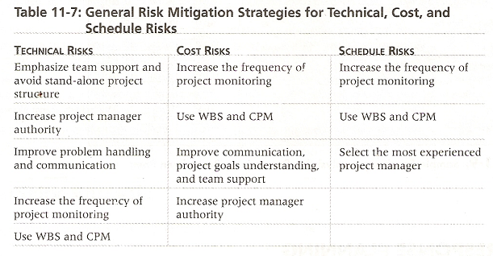
Risk Response Planning:

Slide 47
The four basic response strategies for positive risks are:
1: Risk exploitation: Risk exploitation or doing whatever you can to make sure the positive risk happens.
Example:
If an company funded a project to provide new computer classrooms for a nearby school in need.
The PM might organize news coverage of the project, write a press release, or hold some other public event to ensure the project produces good public relations for the company, which could lead to more business.
2: Risk Sharing:
Risk sharing or allocating ownership of the risk to another party.
Using the same example of implementing new computer classrooms, the project manager could form a partnership with the school’s principal, school board, or parent-teacher organization to share responsibility for achieving good public relations for the project.

Slide 48
The four basic response strategies for positive risks are:
3. Risk Enhancement:
Risk enhancement or changing the size of the opportunity by identifying and maximizing key drivers of positive risks.
E.g.:-An important driver of getting good public relations for the computer classroom projects might be getting students, parents and teachers aware of and excited about the projects.
They could then do their own formal and informal advertising project and company, which in turn might interest other groups and could, generate more business.
4. Risk Acceptance:
It also applies to positive risks when the project team cant or chooses not to take any actions towards a risk.
E.g.:-The computer classrooms, project manager might just assume the project will result in good public relations for their company without doing anything extra.

Slide 49
Using s/w to assist in project risk management
A variety of s/w tools can be used to enhance various risk management processes.
Most organizations use s/w to create, update, and distribute information in their risk registers.
The register (risk registers) is often a simple word or excel file but it can also be part of more sophisticated database.
S/w can be used to create decision trees and estimate expected monetary value.
Most sophisticated risk management s/w, such as Monte Carlo stimulation s/w, can help to develop models & used stimulations to analyze & respond to various risk.
Project 2003 is also being used for same purpose
There are also several s/w packages created specifically for project risk management.
www.risksig.com

Slide 50
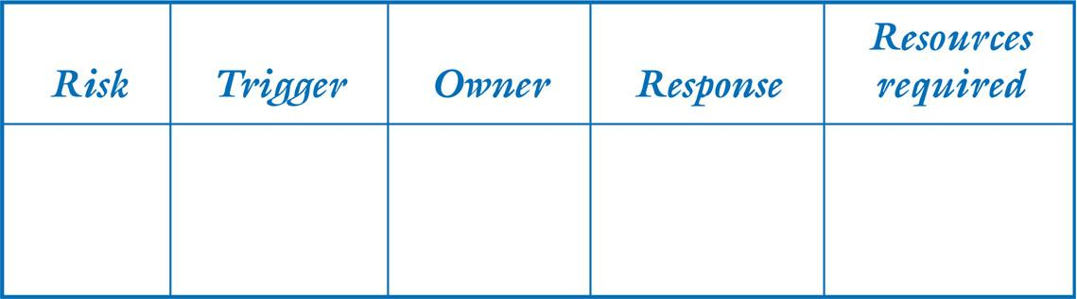
Risk Response Plan should include:
A trigger which flags that the risk has occurred
An owner of the risk (i.e., the person or group responsible for monitoring the risk and ensuring that the appropriate risk response is carried out)
A response based on one of the four basic risk strategies
Adequate resources

Slide 51
Risk Evaluation
Lessons learned and best practices help us to:
Increase our understanding of IT project risk in general.
Understand what information was available to managing risks and for making risk-related decisions.
Understand how and why a particular decision was made.
Understand the implications not only of the risks, but also the decisions that were made.
Learn from our experience so that others may not have to repeat our mistakes.

